Slide 1
Juicing
Originally Created for the HealingStrong@Home program by Cherie Calbom, M.S.
“...For I am the Lord, who heals you.” Exodus 15:26, NIV

Slide 2

The content contained in these meetings are based on the HealingStrong™ “Group Leader’s Guide & Curriculum”, along with all other materials provided to you by HealingStrong™ which are not intended to be medical advice. The information is not intended to diagnose any medical or psychological condition,or to prevent, treat, or cure such medical or psychological conditions. The information is based on research conducted by the authors. HealingStrong™ encourages everyone to make their own health care decisions based on their own judgment, research, and experience. The information is not intended to replace a one-on-one relationship with a medical doctor or qualified healthcare provider. The Information has not been evaluated by the Food and Drug Administration nor the American Medical Association. Promotion of any and all products and services during this meeting is strictly for informational purposes only and not intended as an endorsement of such products or services. No goods or services are sold at these meetings. Guest speakers are not an endorsement by HealingStrong™ and agree also to adhere to the requirements of this disclaimer. HealingStrong™ reserves the right to use any photograph/video taken at this meeting. Although lessons are geared towards healing from cancer, these lessons are educational in nature and offer information that will equip and empower you with health choices and action steps that you can take that may benefit your overall well-being. If you are on a healing protocol, whether preventative in nature, or treatment that is conventional, holistic or integrative, the principles taught in these lessons may be applied towards a supportive plan for many health challenges. Thank you for joining us today!

Slide 3
Opening Prayer

Slide 4
Group Meeting Norms
We want this to be a safe place to share and so let's practice confidentiality.
These meetings are generally not recorded; however, zoom and/or the group leader will alert you if being recorded.
We value everyone’s voice so we would appreciate you keeping side conversations to a minimum.
We are not here to give medical advice but speak from our personal experiences.
Our goal is to have an uplifting conversation that leads us into positive action.

Slide 5
Instructions for Leader
Be sure to check the presenter’s notes for some of the slides, especially Cherie’s story and bio, which are fully written out in the notes.
If you are doing this in a place where you could make juice, a demo is always helpful.

Slide 6
Take Away/Objective
We will learn why juicing fresh vegetables and certain fruits are so important in the healing of cancer and your wellness journey.
You will also discover answers to basic questions about juicing.

Slide 7
Key Concepts
Juicing is So Effective in Promoting Healing and Good Health
There are Superheroes in fresh juice
Frequently Asked Questions About Juice
Cherie’s Story of Hope and Healing

Slide 8
Cherie’s Bio
Leading authority on juicing for health and detoxification.
Known as The Juice Lady, TV chef and celebrity nutritionist.
Author of 35 books including her bestseller Juicing For Life .
Master of Science degree in whole foods nutrition.
Received two Lifetime Achievement Awards.
Awarded Juicing Expert of the Year 2019 by Global Health &
Pharma Magazine.
Lectures worldwide.
www.juiceladycherie.com
Notes:
Cherie Calbom, M.S. is a leading authority on juicing for health and detoxification. Known as
The Juice Lady, TV chef and celebrity nutritionist, she has helped in pioneering the fresh juice
movement around the world. Cherie writes a juice column for Breast Cancer Wellness Magazine
and is the author of 35 books including her bestseller Juicing For Life with over 2 million books
sold. She holds a Master of Science degree in whole foods nutrition from Bastyr University
where she sat on the Board of Regents for five years. Cherie has received two Lifetime
Achievement Awards and was also awarded Juicing Expert of the Year 2019 by Global Health &
Pharma Magazine. Cherie has lectured worldwide on juicing, detoxing and fasting including
consulting for the Royal Family of the UAE. She and her husband offer juice and raw foods
retreats throughout the year. For more information, go to www.juiceladycherie.com

Slide 9
Cherie’s Story
Sick with Chronic Fatigue Syndrome and Fibromyalgia.
Could not find a doctor that offered any help.
Did her own research and learned about juicing.
Did a 5-day vegetable juice fast.
On day five, her body expelled a tumor the size of a golf ball with a number of blue blood vessels attached.
Blood vessels she saw represent angiogenesis—the creation of blood vessels that grow to the tumor to supply food.
Phytonutrient apigenin, found in celery juice, cuts off these blood vessels.
Notes:
Years ago, she had to quit my job because she was sick with Chronic Fatigue Syndrome and
Fibromyalgia. She could not find a doctor that offered any help for my condition. She finally did her
own research and learned about juicing. She embarked on a 5-day vegetable juice fast. On day
five, her body expelled a tumor the size of a golf ball with a number of blue blood vessels
attached. What did those blood vessels indicate? From research we know the blood vessels she
saw represent angiogenesis—the creation of blood vessels that grow to the tumor to supply
food. We also know from research that a number of phytonutrients in vegetable juices such as
apigenin found in celery juice, cut off these blood vessels and thus remove the tumor's gravy
train.

Slide 10
Why Juicing is So Effective in Promoting Healing and Good Health?
When you juice fruits and veggies, they are broken down into an easily absorbable form that your body can use quickly.
Body doesn't have to work as hard to get the nutrients from juice.
These super nutrients can go to work right away in your system to renew and heal your body.
Because it is broken down, it spares your organs of digestion a lot of work.
This equates to more energy and more time for your body to work on healing.
Also, the juices offer antioxidants that help your body detoxify.
Notes:
When you juice fruits and veggies, they are broken down into an easily absorbable form that
your body can use quickly. That means it doesn't have to work as hard to get the nutrients from
juice as it does from solid food. These super nutrients can go to work right away in your system
to renew and heal your body. Because it is broken down, like a pre-digested food, it spares your
organs of digestion a lot of work. This equates to more energy and more time for your body to
work on healing. Also, the juices offer antioxidants that help your body detoxify.

Slide 11
Why Juicing is So Effective in Promoting Healing and Good Health?
To really turn your health around, it's important to flood your system with large amounts of fresh vegetable juice.
Cherie recommends that you drink between 2 quarts and a gallon of fresh juice a day.
This will feed your body with optimum nutrients and help you detox.
This addresses two primary areas that contribute to cancer—
  nutrient deficiencies and
  toxicity.
Notes:
To really turn your health around, it's important to flood your system with large amounts of
fresh vegetable juice. Cherie recommends that you drink between 2 quarts and a gallon of fresh
juice a day. This will feed your body with optimum nutrients and help you detox. This addresses
two primary areas that contribute to cancer—nutrient deficiencies and toxicity.

Slide 12
Superheroes in fresh juice:
Enzymes -
  Fresh juice offers those living molecules known as enzymes.
  Without enzymes, we would not have life in our cells.
  Enzymes help breakdown our food in the digestive tract.
  This is one reason raw juice requires very little energy expenditure during digestion.
Notes:
Fresh juice offers those living molecules known as enzymes that get cooked right out of most of
our food. Without enzymes, we would not have life in our cells. Enzymes help breakdown our
food in the digestive tract. This is one reason raw juice requires very little energy expenditure
during digestion.

Slide 13
Superheroes in fresh juice:
Phytonutrients -
  Plant chemicals help to protect plants from disease and prevent disease.
  Many phytonutrients such as apigenin, luteolin and kaempferol have been shown to fight cancer and prevent disease in the human body.

Slide 14
Superheroes in fresh juice:
Biophotons -
  Photons are the light rays of energy found in plants, which they absorb from the sun.
  Biophotons feed the mitochondria of the cells, which produce ATP—our body’s energy fuel.
  They are believed to contribute to our energy, vitality and a feeling of vibrancy and well-being.
  Heat destroys them.

Slide 15
Frequently Asked Questions About Juice
Next we’ll cover several frequently asked questions about juice and juicing.

Slide 16
Does juice have too much sugar?
Vegetable juice has very little sugar with the exception of carrot and beet juice.
Dilute those with plenty of green juices.
You can flavor veggie juice with lemon or lime.
You can sweeten it with a little green apple or berries.
Green vegetables, ginger, turmeric root, garlic and lemon and lime have virtually no sugar.
Notes:
Vegetable juice has very little sugar with the exception of carrot and beet juice. Cherie recommends
that you dilute those with plenty of green juices. You can flavor veggie juice with lemon or lime.
You can sweeten it with a little green apple or berries. Green vegetables, ginger, turmeric root,
garlic and lemon and lime have virtually no sugar.

Slide 17
Does juice have too much sugar?
Even diabetics can juice greens, especially green bean juice.
many people in the health professions have no idea that greens can be juiced.
They are talking about fruit juice when they say that juice has too much sugar.
Cherie does not recommend drinking straight fruit juice because of the sugar content.
The lowest sugar fruits are berries and green apples
Notes:
Even diabetics can juice greens, which is very
helpful for that condition, especially green bean juice. But many people in the health
professions have no idea that greens can be juiced. They are talking about fruit juice when they
say that juice has too much sugar. Cherie does not recommend drinking straight fruit juice because of
the sugar content. The lowest sugar fruits are berries and green apples.

Slide 18
During cancer treatments, who should NOT drink raw juice?
Anyone going through a treatment that causes the immune system to be extremely depressed and are told they can't have any raw food during that treatment should not drink raw juice.
Everyone else can greatly benefit from fresh raw juice each day.

Slide 19
Why should we juice? Why not just eat the fruits and vegetables?
We can juice far more produce than we would probably eat in a day.
We can juice parts of the plant we wouldn't normally eat like stems, leaves and seeds.
Juice is broken down so well it gives the digestive system a rest.

Slide 20
What is the difference between juicing and blending?
A juicer extracts juice by separating it from the fiber.
A blender such as the Vitamix or Ninja blends the produce in one container keeping everything in the mixture.
Both smoothies (blended drinks) and juice are good and have their place.
But juice is very important to include in a healing diet and healthy lifestyle.
Nothing can replace vegetable juice.
Notes:
There is some confusion between juicers and blenders. A juicer extracts juice by separating it
from the fiber. A blender such as the Vitamix or Ninja blends the produce in one container
keeping everything in the mixture. Both smoothies (blended drinks) and juice are good and
have their place. But juice is very important to include in a healing diet and healthy lifestyle.
Nothing can replace vegetable juice.

Slide 21
So why should you juice and not just blend everything up?
Juice is broken down so well that your body can absorb the nutrients easily. This is an important factor in the healing process.
You can juice more than you can blend. With a blender, you are limited to what your container holds.
Many people don't like the mushy, fiber-rich consistency of high-vegetable content smoothies. Therefore, they use a lot of fruit, often too much fruit, so it will be palatable.
You can juice hard vegetable parts that don't blend well such as broccoli and asparagus stems.

Slide 22
Do we need the fiber that’s lost in juicing?
We absolutely need fiber in our diet.
But we don't need fiber in every mouthful of food or drink.
We drink fresh veggie juice as a great supplement to our diet, as a juice fast cleanse or as a therapeutic approach to healing.
It's interesting to note that no one ever complains there's no fiber in wine.
As for the nutrients in the fiber, in 1996, the US Department of Agriculture analyzed twelve fruits and found that 90% of the nutrients they measured was in the juice rather than the fiber.

Slide 23
What about fresh juice versus refrigerated store-bought juice?
Fresh juice is live food, rich in enzymes, vitamins and biophotons that are all killed with heat.
Unless a commercial juice is not pasteurized, it will not have these nutrients.
Very few commercial juices have met the government criteria for safety without pasteurization.
The few that have are quite expensive because of the processing.

Slide 24
How long can fresh juice be stored? And can it be frozen?
If you use a centrifugal juicer, you can usually store fresh juice for 24 hours.
If you use a masticating or cold press juicer, it's usually 48 hours.
It's best to store in the refrigerator in an airtight container.
You can freeze juice. It will last in the freezer about 3 months.
It works well to freeze in small canning jars.
Don't fill all the way to the top as the juice will expand. Leave some room, like about 2 inches at the top or your glass will break.

Slide 25
How much produce does it take to make a glass of juice?
These items yield about one 8-ounce glass of juice:
  five to seven large carrots or
  one large cucumber.
The following each yield about 4 ounces of juice:
  one large apple,
  three to four large (13-inch) ribs of celery or
  one medium grapefruit (4-6 oz).

Slide 26
What type of juicer is best?
One you will use every day.
Centrifugal Juicer - a juicer that is easy to clean, fast and has a wide mouth that will take larger pieces of produce.
Masticating Juicer - If you don't mind spending a little more time and you want one that presses the juice, preserves more nutrients and will do more delicate greens such as parsley. These require that you cut produce up into small pieces which takes more time.
It doesn't really matter if you preserve a few more nutrients though if you never use your juicer because it's too time consuming to make juice.
Cherie recommends the Nama J2 Juicer.
Notes:
To make this really simple, Cherie always says it's the one you will use every day. It's not the one a salesperson talks you into because it does a lot of great things. You need to find one that fits your lifestyle. If you're looking for a juicer that is easy to clean, fast and has a wide mouth that will take larger pieces of produce, you are looking at a centrifugal juicer. If you don't mind spending a little more time and you want one that presses the juice, preserves more nutrients and will do more delicate greens such as parsley, then you want a masticating juicer. It doesn't really matter if you preserve a few more nutrients though if you never use your juicer because it's too time consuming to make juice. Masticating juicers require that you cut produce up into small pieces which takes more time. Get a juicer you will use every day. Cherie recommends the Nama J2 Juicer.

Slide 27
How important is it to use organic produce?
Many pesticides are known to cause cancer.
It is very important to purchase organic produce as much as you possibly can.
Studies show there is a greater incidence of cancer, particularly lymphoma, leukemia and cancer of the brain, skin, stomach, and prostate among crop workers and farmers and their family’s.
Studies also show that across the board, whatever vegetable or fruit you consider, organic has a higher nutrient content than conventional (sprayed) produce.

Slide 28
How important is it to use organic produce?
Look for certified organic. It's worth the extra money.
At a minimum, always purchase organic when it comes to the "Dirty Dozen."
  Each year the EWG tests fruits and vegetables and publishes the list of the most heavily sprayed fruits and veggies.
  They are most often the thin-skinned produce such as apples, grapes, berries and spinach.
Conversely, the Clean Fifteen has very little spray and you are fairly safe buying conventional produce within that group.
You can download an app for your phone at WWW.EWG.ORG.
Notes:
Look for certified organic. It's worth the extra money because your health is priceless.
If you absolutely can't afford to buy everything organic, always purchase organic when it comes to the "Dirty Dozen."
Each year the Environmental Working Group tests fruits and vegetables and publishes the list of the most heavily sprayed fruits and veggies.
They are most often the thin-skinned produce such as apples, grapes, berries and spinach. Conversely, the Clean Fifteen has very little spray and you are fairly safe buying conventional produce within that group. You can download an app for your phone, so you've got the info when you go shopping. Go to WWW.EWG.ORG.

Slide 29
Recipe: Celery Juice
Celery juice first thing in the morning on an empty stomach is recommended.
It is a must for anyone with cancer since the phytonutrient apigenin cuts off blood supply to tumors.
  2 bunches of organic celery
  Small piece of cucumber
  Seed your juicer with a little cucumber if you are using a centrifugal juicer.
  The celery is quite stringy and the fiber can clump on the blade basket and cause it to jump.
  Juice ingredients and stir.
Notes:
Celery is rich in align which prevents, suppresses and reverses cancer; inhibits angiogenesis depriving tumors of blood, oxygen and nutrients. Stimulates neurogenesis. The leaves are even higher in apegenin so be sure to get the leafy celery and juice the leaves. It can prevent cardiovascular disease too. It reduces glucose, blood pressure, and blood lipids. It has anti-fungal and anti-inflammatory properties as well. Cherie learned this from https://www.ncbi.nlm.nih.gov/pmc/articles/PMC5871295
Recipes from The Juice Lady's Living Foods Revolution (Siloam)

Slide 30
Recipe: You Are Loved Cocktail
3 carrots, scrubbed well, tops removed, ends trimmed
2 celery stalks, with leaves
1 cucumber, peeled if not organic
1 handful spinach
1 lemon, peeled if not organic
1/2 green apple
Cut produce to fit your juicer’s feed tube. Juice all ingredients and stir. Pour into a glass and drink as soon as possible.
Serves 1-2
Notes:
Spinach helps with learning. Flavonoids reduce plaque buildup that is associated with Alzheimer’s disease. One study published in experimental neurology showed less brain damage from restricted blood supply and increased motor function following a stroke.
Carrots contain Falcarinol, a mild antiseptant, which consumed reduces risk of some sorts of cancer by up to 33%.
Cucumbers, apples and strawberries are rich in the flavonoid fisetin which affects multiple molecular and signaling pathways depending on the cancer type.
Recipes from The Juice Lady's Living Foods Revolution (Siloam)

Slide 31
Recipe: The Ginger Hopper With A Twist
5 medium carrots, scrubbed well, green tops removed, ends trimmed
1/2 green apple
1-inch piece fresh ginger root, peeled
1/2 lemon, peeled if not organic
Cut produce to fit your juicer’s feed tube. Juice ingredients and stir. Pour into a glass and drink as soon as possible.
Serves 1
Notes:
Lemon: Limonene in citrus peel oil reduces tumors by 60% in 6-8 weeks!
Carrots: Scientists have shown that at high doses beta-carotene can kill cancer cells grown in the lab.
Recipes from The Juice Lady's Living Foods Revolution (Siloam)

Slide 32
Recipe: Veggie Time
4 carrots, scrubbed well, green tops removed, ends trimmed
1 turnip, scrubbed well
1 lemon, peeled if not organic
2-inch chunk jicama, scrubbed or peeled if not organic
1 handful watercress
1 garlic clove
Cut produce to fit your juicer’s feed tube. Juice ingredients and stir. Pour into a glass and drink as soon as possible.
Serves 1-2
Notes:
Watercress: A plant compound called phenyl ethyl isothiocyanate in watercress blocks blood vessel formation to tumors - interferes with the ‘turns off’ of a protein called HIF.
Watercress: Helps heal thyroid and prevent weight gain. Contains iodine - number one healer of under-active thyroids.
Recipes from The Juice Lady's Living Foods Revolution (Siloam)

Slide 33
Good, Better, Best Tips
Good: Research juicers and buy one you are willing to use.
Better: Make juice on weekends and freeze it. Follow the Clean Fifteen and Dirty Dozen to determine what produce to buy conventional versus organic.
Best: Make juice every day from all organic produce.
Notes:
As each lesson concludes, we want to leave you with an idea(s) for how to implement a suggestion from the lesson in an incremental fashion that meets your needs and abilities. Each lesson will give you ideas that are “Good, Better, and Best”.
Good Tips: A perfect way to get started implementing healthier healing options. This tip will be less involved from both a time, energy, effort and financial resources.
Better Tips: This tip will progress you further into implementing the lesson idea. More time and cost may be involved in this step.
Best Tips: When you are ready, this tip will give you ideas to help implement the lesson ideas in a more extensive fashion. This could mean significant investment of time, energy, effort, and financial resources.

Slide 34
Discussion Questions / Action Steps
What is one takeaway about why is it important to juice vegetables for health and healing?
Do you know how to juice now with less sugar?
During cancer treatments, who should not juice?
What is the most important juice you can drink if you have cancer?
How important is it to juice organic vegetables?
Which juicer is best for you?
How can you make juicing simplified to fit your lifestyle?

Slide 35
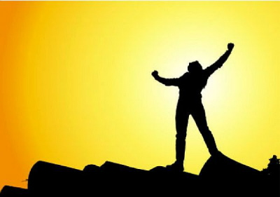
Let go of fear!
Fear is detrimental to healing, but affirmations based on God's Word will help us replace it with courage and strength.

Slide 36
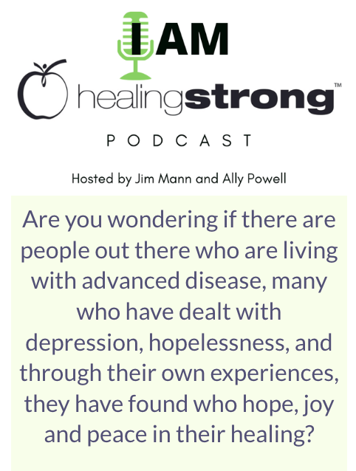
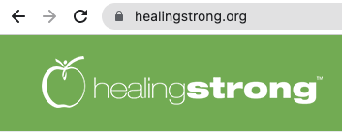
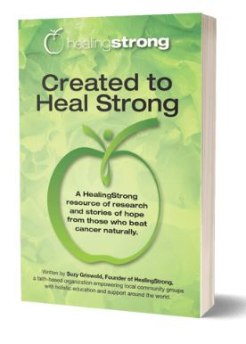
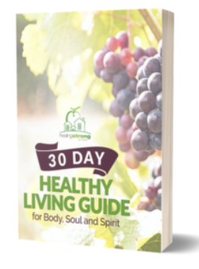
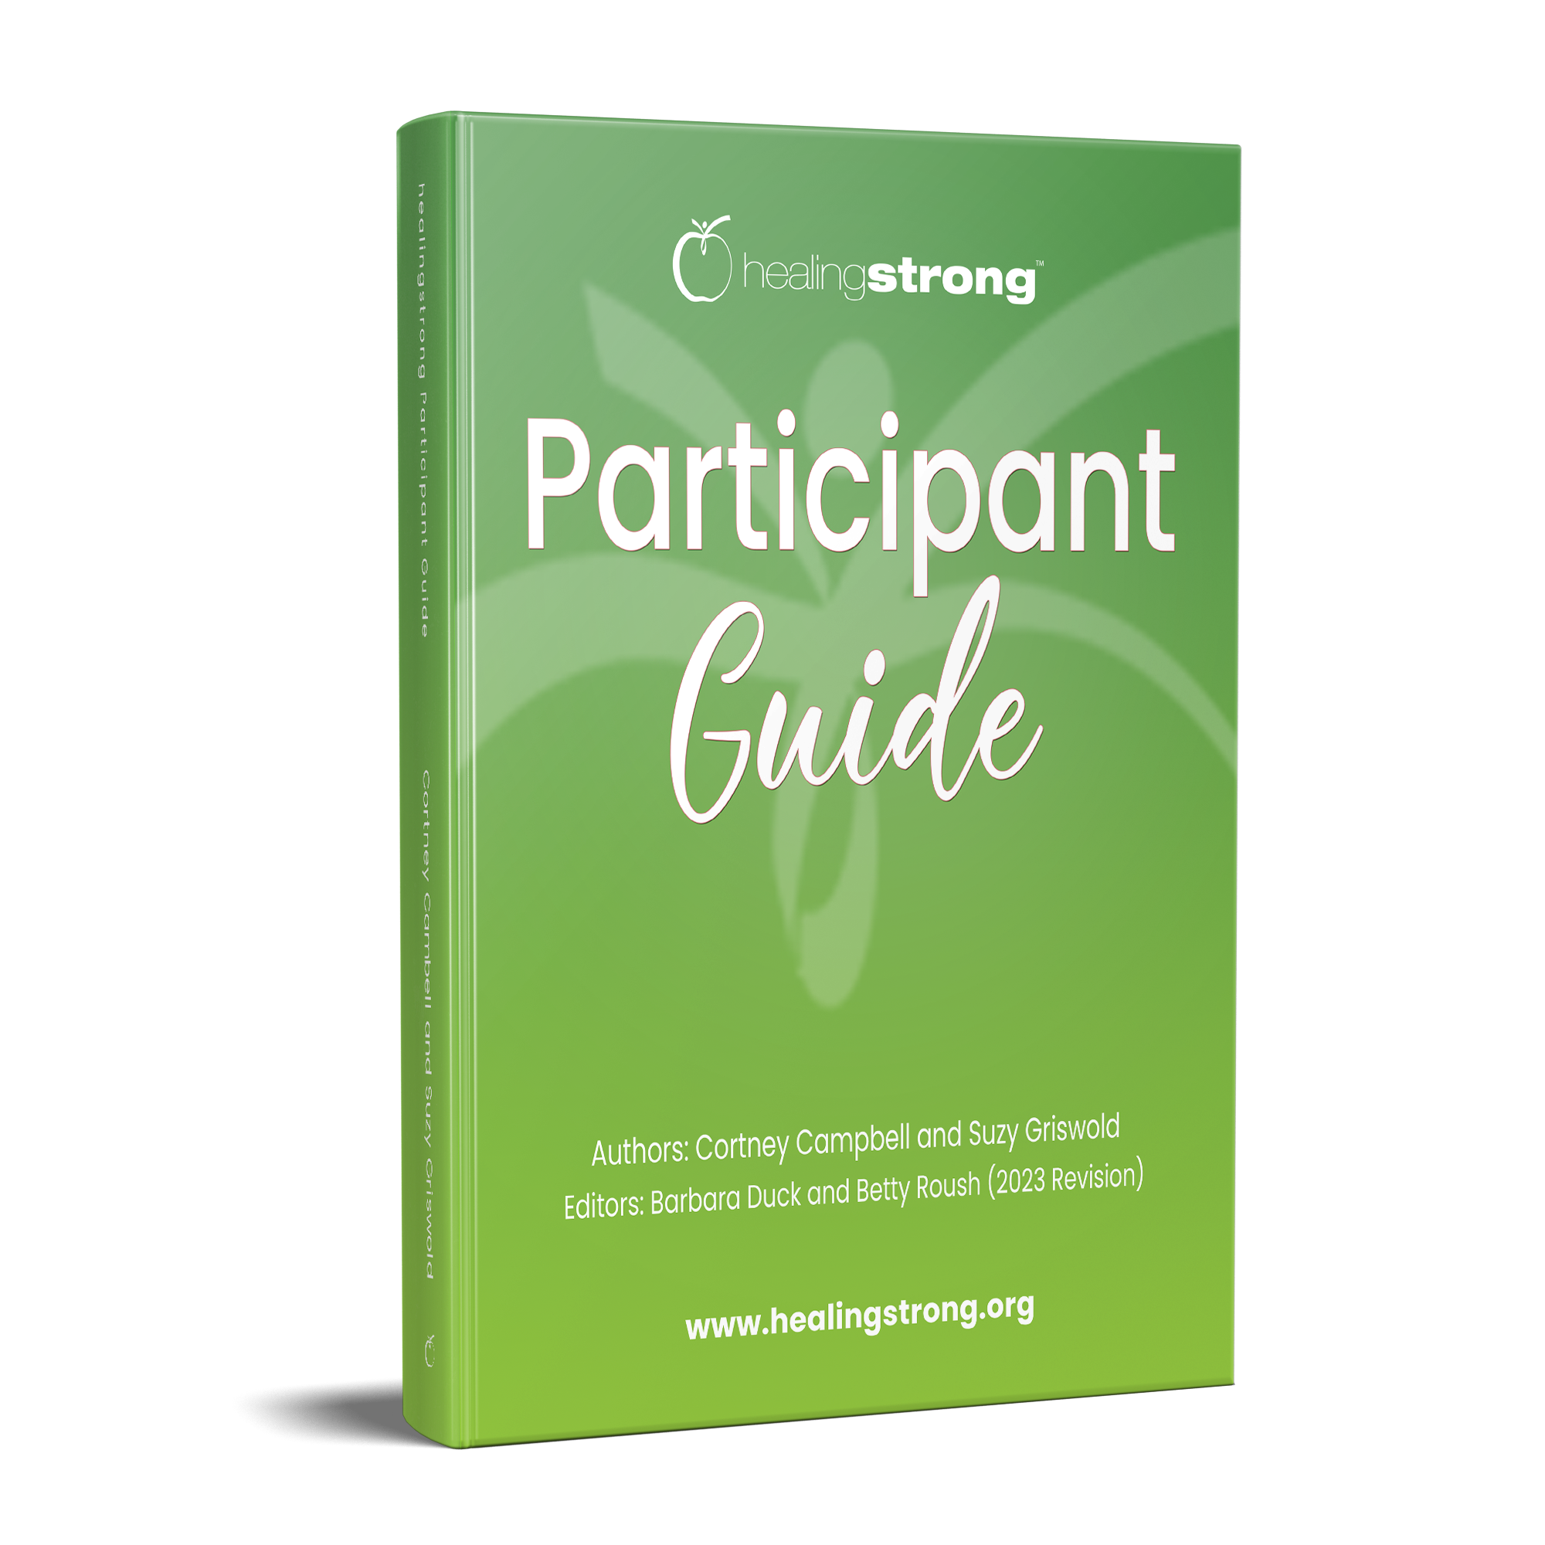

Other HealingStrong™ Offerings

Slide 37
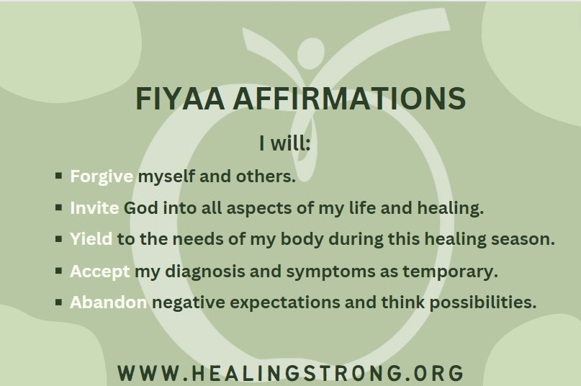
HealingStrong™ FIYAA Affirmation

Slide 38
Additional Resources for Further Use
Sign up for Cherie's newsletter at www.juiceladyinfo.com
Books by Cherie Calbom
  The Juice Lady’s Guide to Fasting (Siloam)
  The Juice Lady’s Remedies for Diabetes (Siloam)
  Sugar Knockout (Siloam)
  Abby Fammartino, The Juice Lady’s Anti-Inflammation Diet (Siloam)
  The Juice Lady’s Big Book of Juices and Green Smoothies (Siloam)
  The Juice Lady’s Remedies for Stress and Adrenal Fatigue (Siloam)
  The Juice Lady’s Living Foods Revolution (Siloam)
  Souping is the New Juicing (Siloam)
  The Juice Lady’s Turbo Diet (Siloam)
  The Juice Lady’s Guide to Juicing for Health (Avery)

Slide 39
Additional Resources for Further Use
The Juice Lady Retreats offer gourmet organic raw foods and juices and a 3-day juice fast midweek. There is a daily exercise class designed to help you detox. Informative classes are offered daily that include nutrition, physical detoxing, emotional detox, mental detox, de-stressing and heart biofeedback. We also offer a healing prayer service. The retreats are held in a beautiful, peaceful setting where you can experience healing and restoration of body and soul. For more information, go to www.juiceladyinfo.com
You can purchase one of her Programs Classes at https://juiceladycherie.com/shop/programs/

